Slide 1

Easy Website Creation with WordPress: A Comprehensive Tutorial

Slide 2
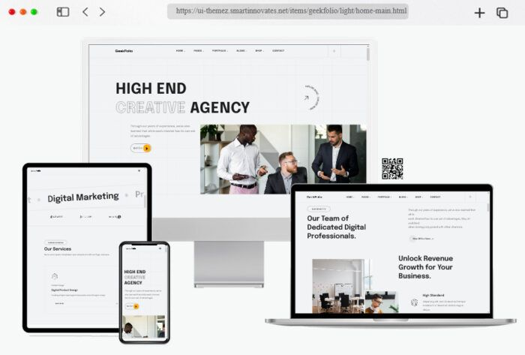
Introduction
What is Website ?
Definition: A website is a collection of interconnected web pages under a single domain name, accessible via the internet.
Components:
Web Pages: Individual documents or files that make up the website, including text, images, videos, and links.
Domain Name: The address users type in their browser to access the website (e.g., www.example.com).
Web Hosting: A service that stores website files and makes them available on the internet.

Slide 3
Importance of a Website : In This Era
Online Presence: Enhances visibility and discoverability
Credibility and Trust: Builds professional image and trust
24/7 Availability: Offers information and services around the clock
Marketing Tool: Key platform for SEO, content, and social media marketing
Customer Engagement: Enables interaction through blogs, contact forms, etc.
Global Reach: Attracts a worldwide audience
Cost-Effective: Reduces marketing and operational costs
Brand Building: Strengthens brand identity and messaging
Competitive Advantage: Keeps you competitive in a digital-first world
E-Commerce: Facilitates online sales and revenue generation
Analytics and Insights: Provides valuable data on user behavior
Resource Hub: Centralizes content and information for easy access

Slide 4
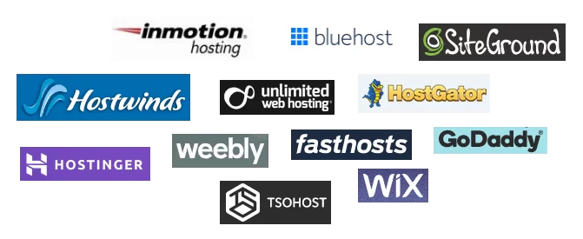

Let’s Start Setting Up Website
Select Hosting Provider and get a Web Hosting Account
What is Hosting?
Hosting refers to the service that stores and makes your website accessible on the internet . In addition web hosting is a service, similar to website builder – that allows you to register domain name and set up a website.
List of Top ten Web Hosting Providers in 2024
Hostinger.
Hostwinds.
SiteGround.
Bluehost.
HostGator.
DreamHost.
Inmotion hosting.
Namecheap.

Slide 5
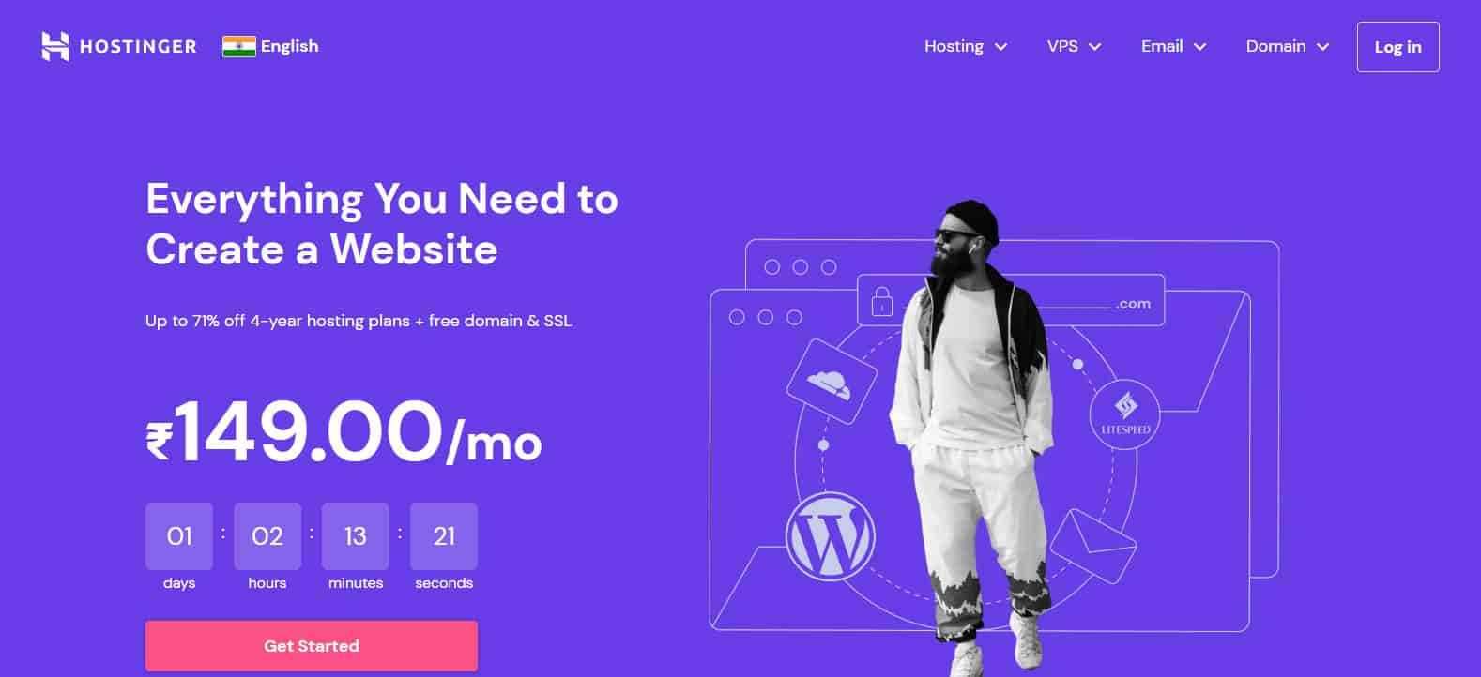
We recommend Web Hosting - Hostinger to everyone who is just starting out
Why Choose Hostinger?
Affordable and competitive pricing
Reliable performance and uptime
User-friendly interface and excellent customer support

Slide 6
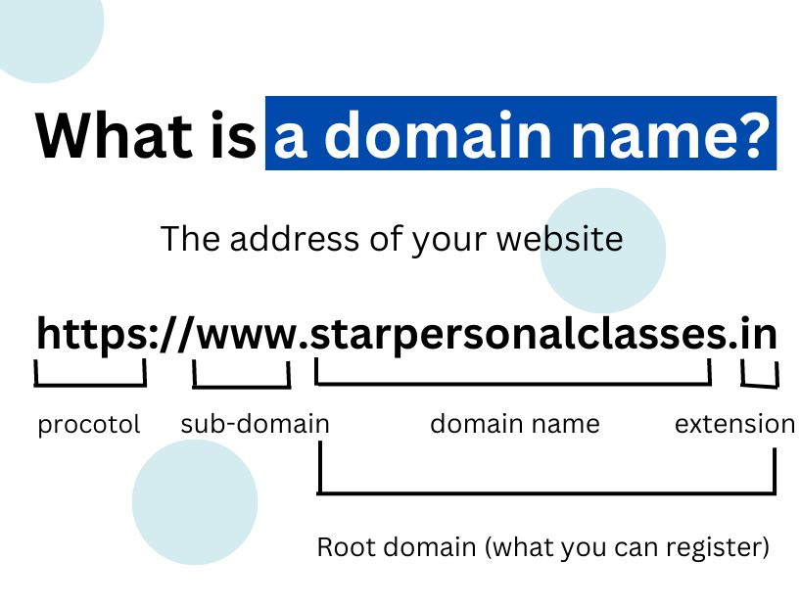
Choose a Domain Name(.www)
What is Domain Name?
A domain name is a website’s equivalent to a physical address. It consists of a name and an extension. It helps users easily find your website and eliminates the need to memorize the site’s internet protocol (IP) address. On top of all, domain names are key to the internet infrastructure.

Slide 7
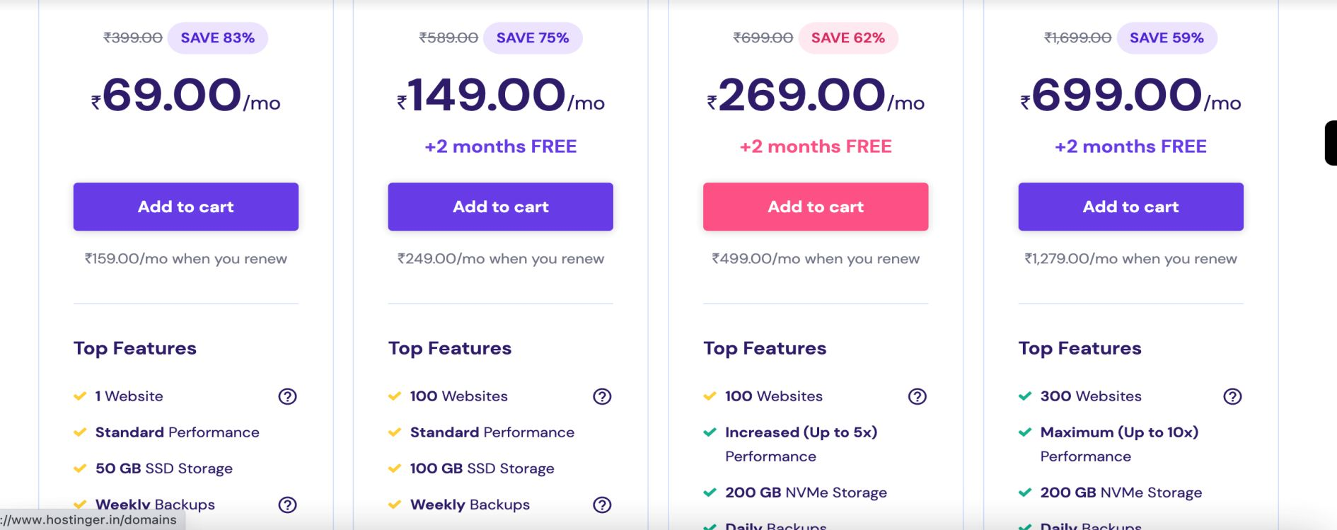
Steps to buying hosting
Step 1 - Visit Hostinger's Website
Go to www.hostinger.com
Explore the various hosting plans available
Step 2 - Select a Hosting Plan
Overview of available hosting plans (e.g., Shared Hosting, VPS, Cloud Hosting)
Choose a plan that fits your needs (e.g., Single Shared Hosting for beginners)

Slide 8
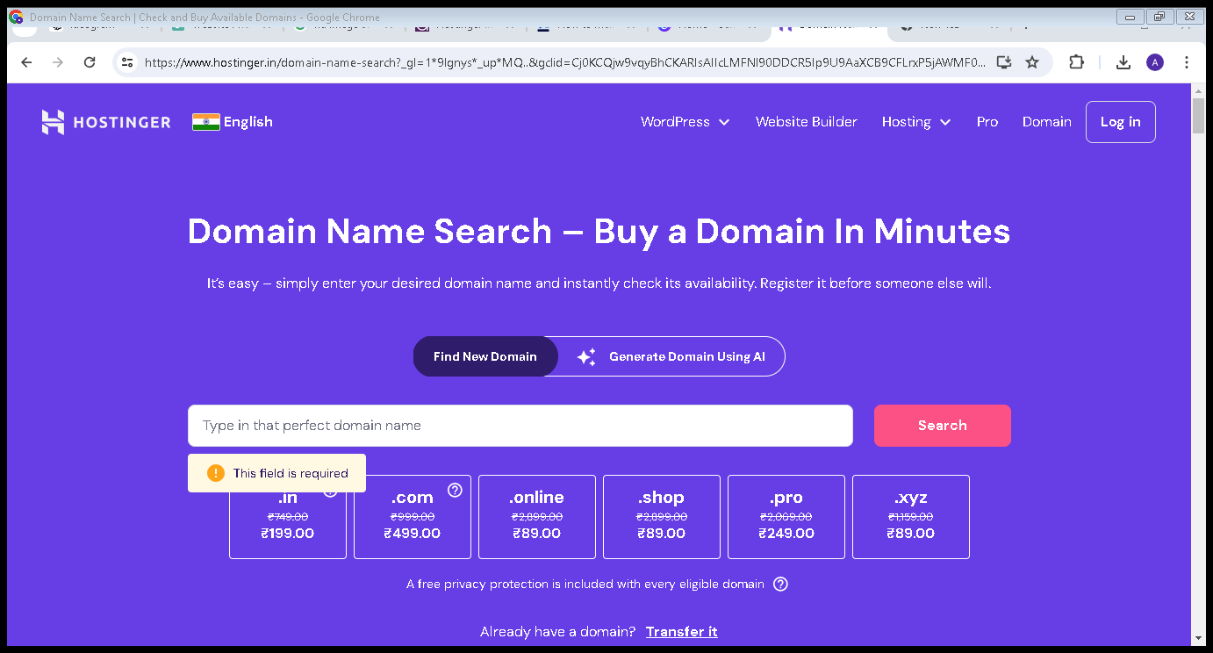
Step 3 - Choose a Domain Name
Importance of a good domain name (easy to remember, relevant to your content)
Enter your desired domain name in the search bar to check availability
Tips for choosing a domain name:
    Keep it short and simple
    Avoid numbers and hyphens
    Use keywords related to your content

Slide 9
Step 4 - Add to Cart and Review Order
Review your selected hosting plan and domain name
Check for any available discounts or promotions
Add any additional services if needed (e.g., SSL certificate, domain privacy)
Step 5 - Create an Account
Enter your email address and create a password
Alternatively, sign up using your Google or Facebook account
Step 6 - Make Payment
Enter your payment information (credit card, PayPal, etc.)
Review and confirm your order
Look out for a confirmation email with your account details
Step 7 - Access Your Hosting Dashboard
Log in to your Hostinger account
Navigate to the hosting dashboard
Familiarize yourself with the dashboard features and settings
Step 8 - Install WordPress
Install WordPress on your hosting account (most hosts offer one-click installations).

Slide 10
In the case, If we buy Web Hosting from Hosting and Domain from Godaddy
Unlock the Domain at GoDaddy
Domain registrars offer a domain lock to protect registration details. When a domain is locked, the owner can’t initiate a transfer, change ownership details, or delete the domain.
GoDaddy enables this feature by default. Here’s how to turn it off:
Sign in to your GoDaddy account and open the Domain Portfolio page.
Click on the three-dot icon next to the domain name you want to transfer and select Turn Lock Off.

Slide 11
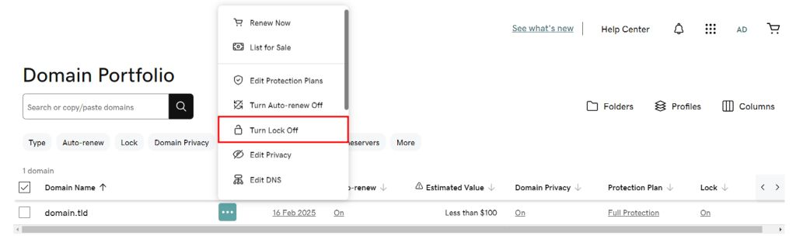
Read the disclaimer and click Continue to confirm. If you enable Domain Protection, verify your identity by entering the code sent via SMS or your authenticator app. Alternatively, input the one-time password sent to your email.
If the process is successful, the domain’s lock status should change to Off.

Slide 12
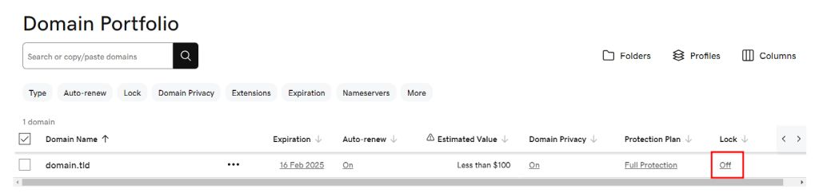
2. Point the Domain to Hostinger Nameservers
A domain name system (DNS) translates domain names into IP addresses, allowing browsers to locate and load the websites. When you transfer a domain, DNS settings often become temporarily locked, preventing edits.
To keep your website and email services running smoothly, point your domain to Hostinger before starting the domain transfer process.
Here’s how to do it:
Open the Domain Portfolio page.
Click on the three-dot icon next to the domain name you want to transfer and select Edit DNS.

Slide 13
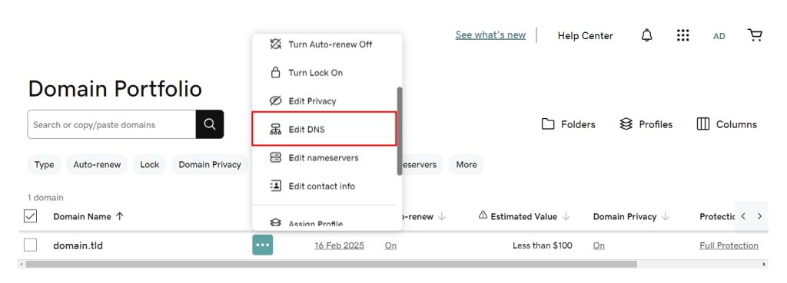
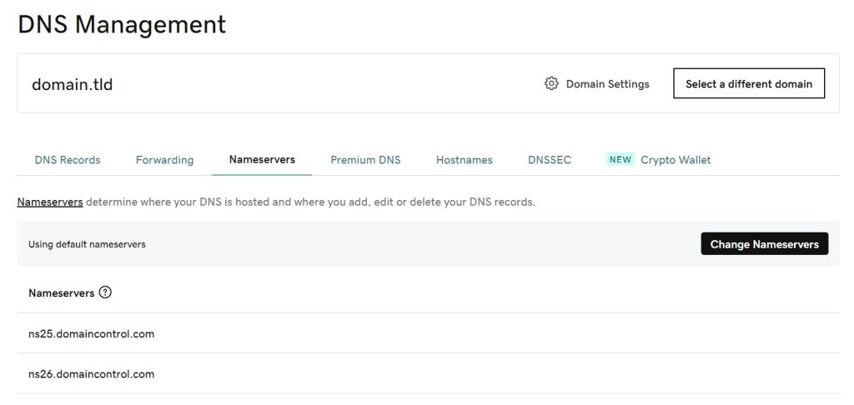
Open the Nameservers tab and select Change Nameservers.
Choose I’ll use my own nameservers and enter Hostinger’s nameservers ‒ ns1.dns-parking.com and ns2.dns-parking.com.

Slide 14
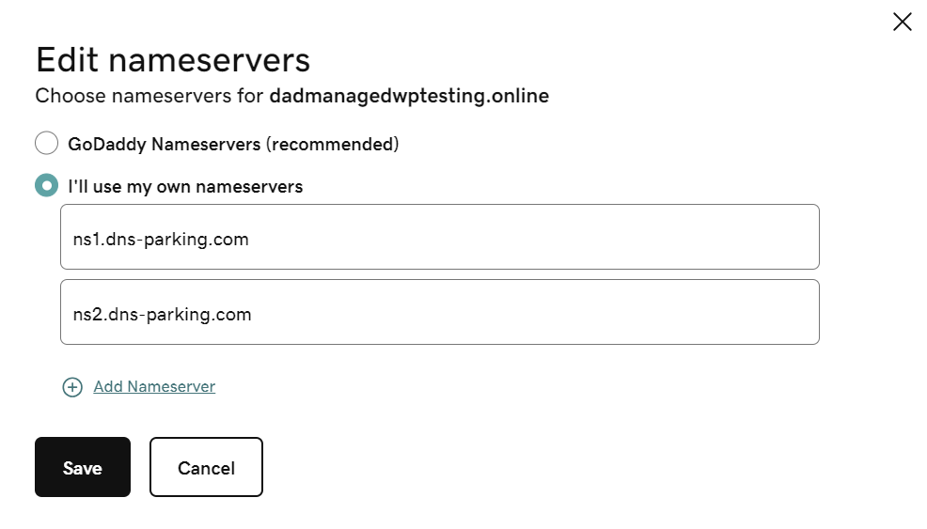
Click Save once you’re done. The DNS will take up to 24 hours to fully propagate worldwide.
3.Obtain the Authorization Code
Follow these steps to obtain your EPP code on GoDaddy:
Open the Domain Portfolio page and click on the domain you want to transfer.
Scroll down to the Transfer section and click Transfer to Another Registrar

Slide 15
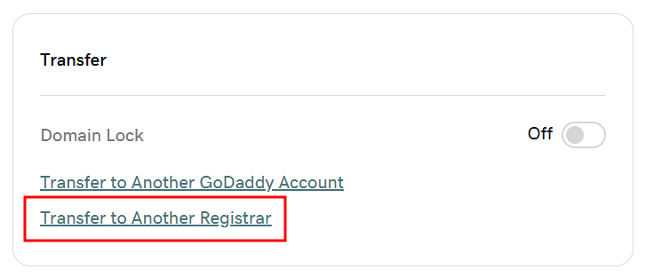
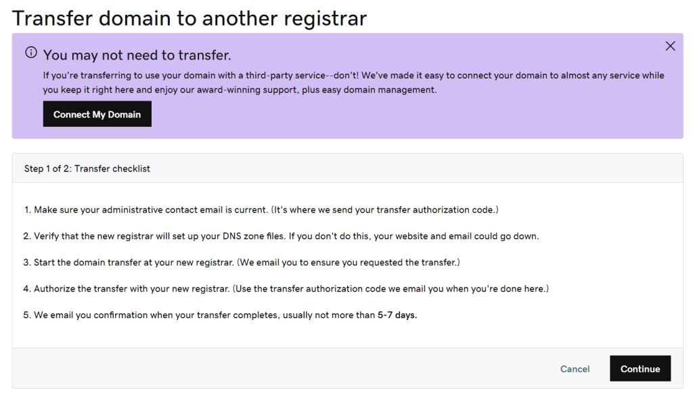
Review the transfer checklist and select Continue.

Slide 16
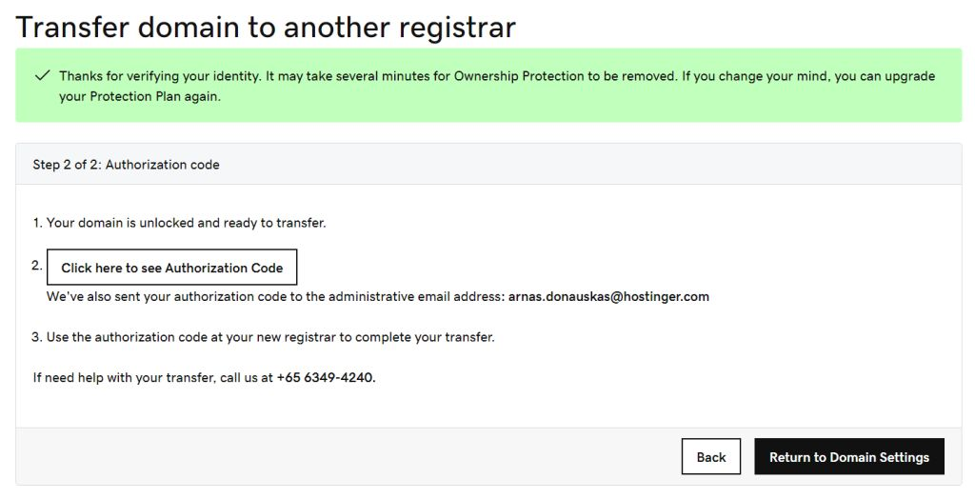
Read the final disclaimer and click Continue. This step deactivates domain privacy to ensure the contact details are transferred to the new registrar.
Select Click here to see Authorization Code to obtain the EPP code. GoDaddy will also send the authorization code to your domain’s administrative email address.

Slide 17
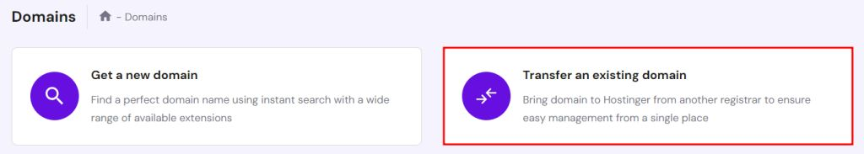
4. Initiate Domain Transfer to Hostinger
After getting the Auth-Code from GoDaddy, purchase the domain transfer service from Hostinger’s hPanel dashboard.
Here’s how to do it:
Log in to your Hostinger account and head to Domains. Select Transfer an existing domain to start the migration process.

Slide 18
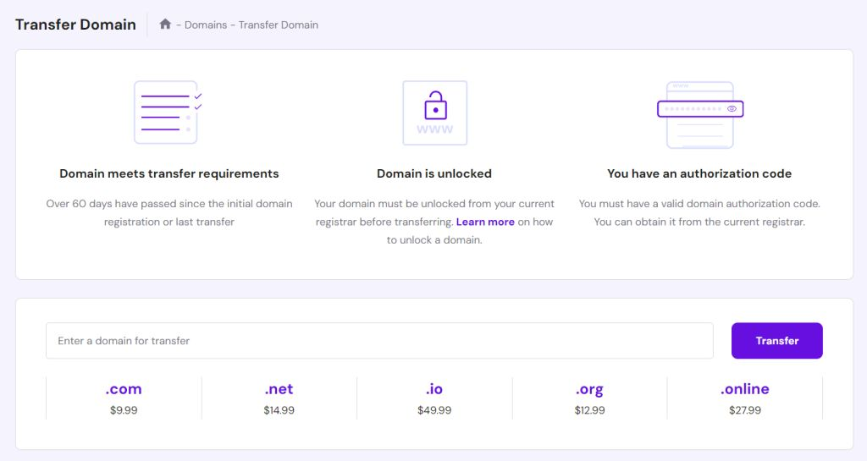
Enter the domain you want to migrate and hit Transfer.
If your domain name is transferable, you’ll view the total transfer and renewal cost. Click Transfer to confirm.

Slide 19
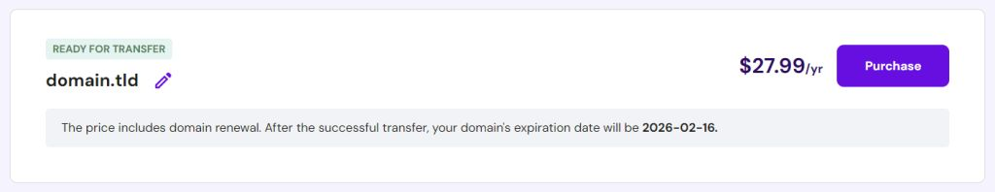
After making the payment, enter the EPP code and select Use Hostinger nameservers.
Confirm the transfer via the email sent to you.
The domain transfer process takes between five to seven days to complete, depending on the previous registrar and the top-level domain (TLD).

Slide 20
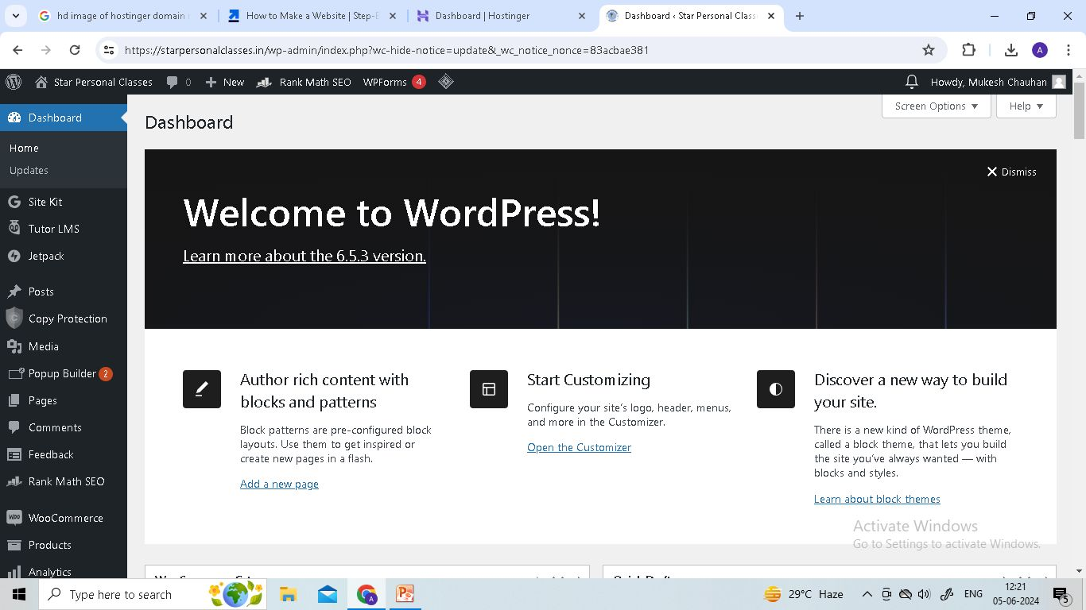
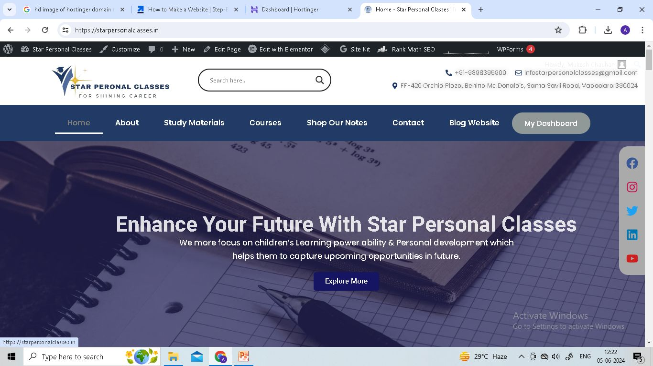
What is WordPress?
WordPress is a free, open-source content management system (CMS).
Two versions: WordPress.com (hosted) and WordPress.org (self-hosted).
Used by millions of websites worldwide for its flexibility and ease of use.
Website Backend
Website Frontend

Slide 21
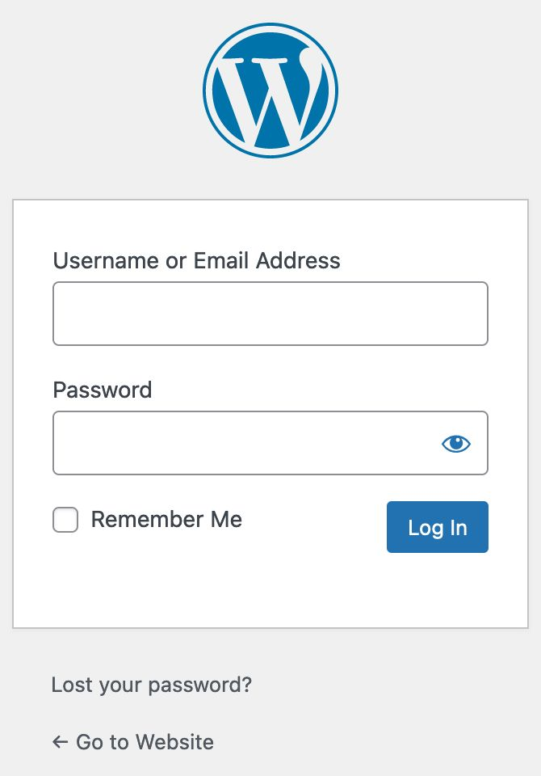
Getting Started with WordPress
Log in to your WordPress dashboard (usually at yourdomain.com/wp-admin).
Enter your Username and Password(Enter at the time of installation of WordPress)
Familiarize yourself with the dashboard components: Posts, Pages, Media, etc.

Slide 22
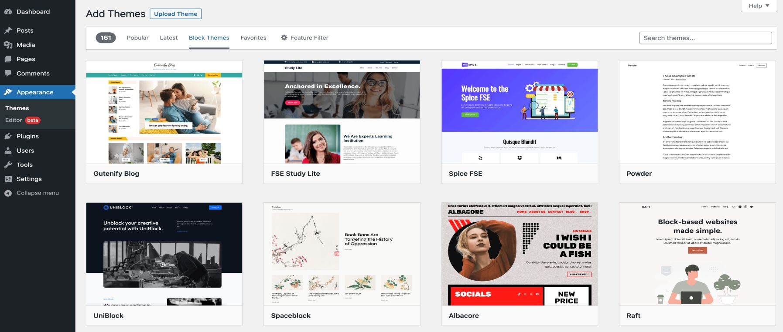
Choosing a Theme
Themes control the design and layout of your website.
Browse free and premium themes from the WordPress theme directory or third-party sites.
Go to Appearance> Click Themes> Click Add New Theme> Search Theme(i.e. Astra)> Click Install >Click Activate
Install and activate a theme, then customize it to match your brand.
Here, I Choose Astra Theme

Slide 23
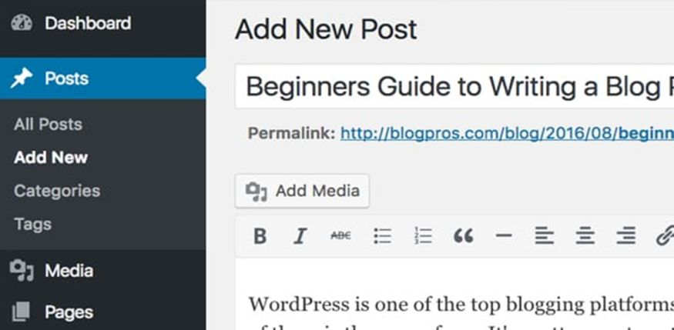
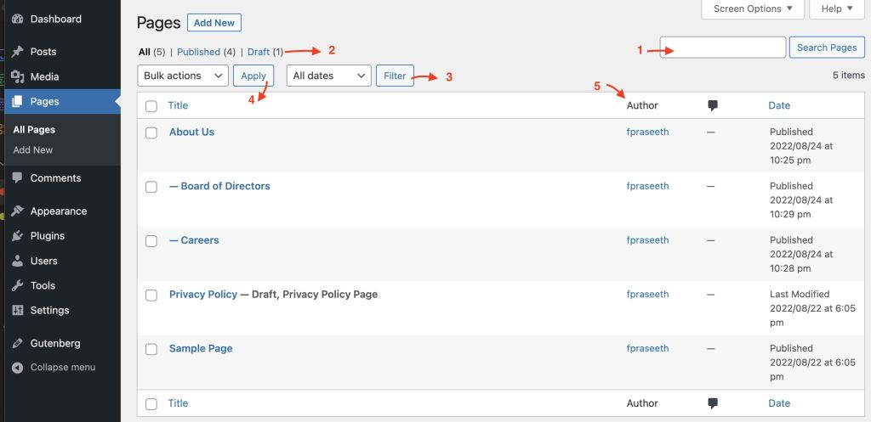
Adding Content
Posts are for blog entries, news updates, and other timely content.
Pages are for static content like About, Contact, and Services.
Create a new post or page by navigating to Posts > Add New or Pages > Add New.
WordPress Pages Interface
WordPress Blog Post Interface

Slide 24
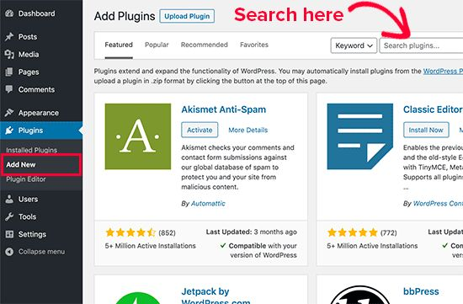
Plugins
Plugins add extra functionality to your WordPress site.
Browse and install plugins from the WordPress plugin directory.
Essential plugins include SEO tools, security plugins, and backup solutions.

Slide 25










Plugins we need for creating E-Commerce Website
Elementor
Elementor Header & Footer Builder
Essential Addons for Elementor
WooCommerce(To Create Products & Shop page)
Rank Math SEO
LiteSpeed Cache
UPI QR Code Payment Gateway
Razorpay for WooCommerce
Ajax Search Lite
WPForms Lite

Slide 26
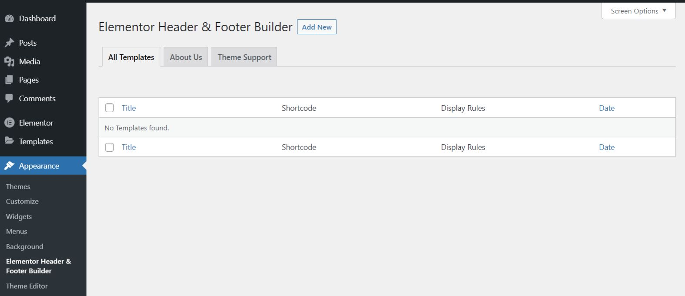
Design Header and Footer
1
Steps to Create Header:-
Go to Appearance > Elementor Header & Footer Builder > Add New> Add Title> Publish> Edit with Elementor

Slide 27
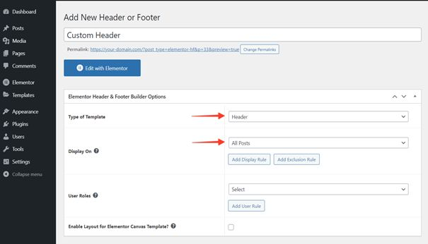
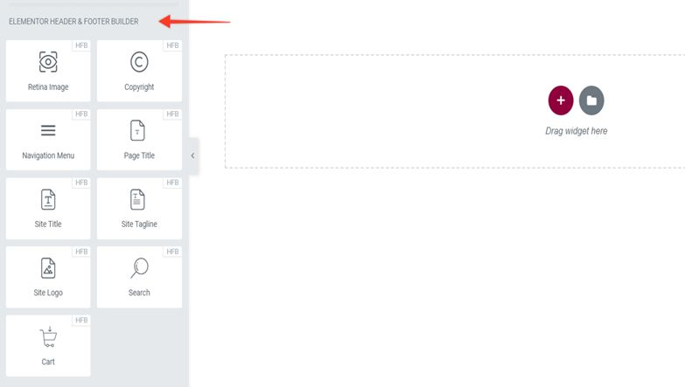
2
3

Slide 28
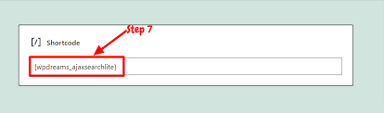
Click on the + icons Select Structure Three Columns(according to your requirement)
On the Left hand side other Editing options available, for creating header
In first column we choose image icon , upload your logo here & you can edit your logo design , typography, color etc..
In second column we put search bar, here you have to select shortcode option put Ajax Search Lite (Short code)here
In Third column, We Select Nav Menu after Select Main Menu
Ajax Search Lite Shortcode

Slide 29
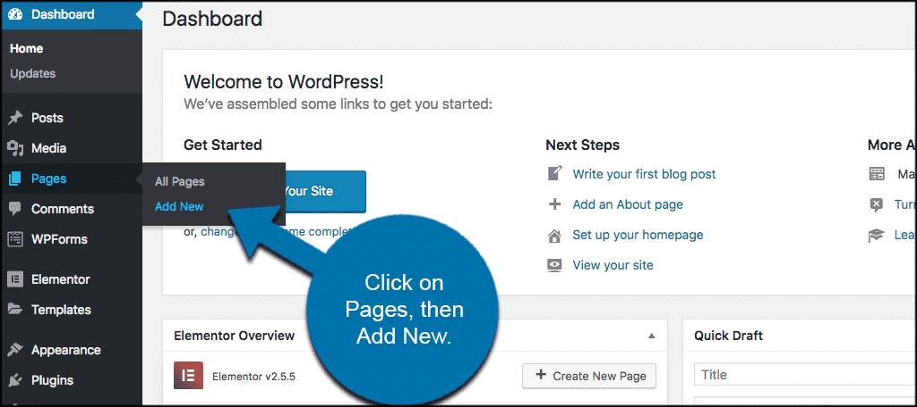
Design Home Page
Step1: Go to the Pages Section of the Dashboard
From the top left side of the WordPress dashboard, click Pages > Add New.

Slide 30
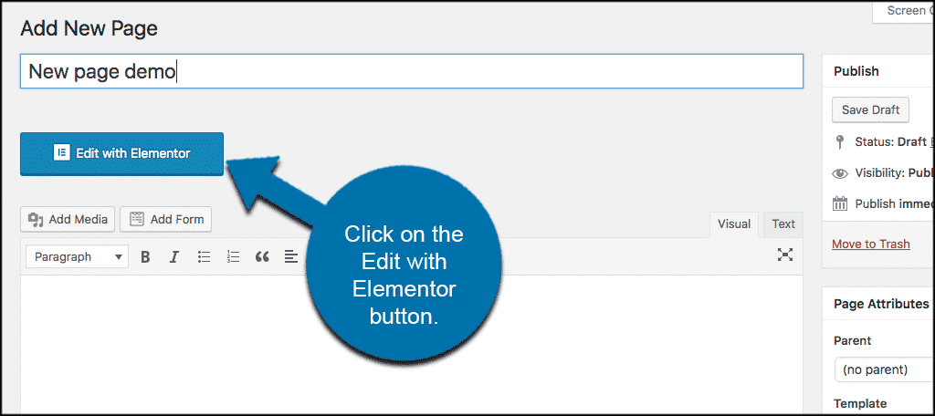
Step 2: Click on the Edit with Elementor Button
Now click the “Edit with Elementor” button to enter Elementor Page Builder. You will see this option available if Elementor has been installed and activated properly.
Note: WordPress 5.0+ (Gutenberg) Compatibility. Use the “Edit with Elementor” button within Gutenberg. Same as above.

Slide 31
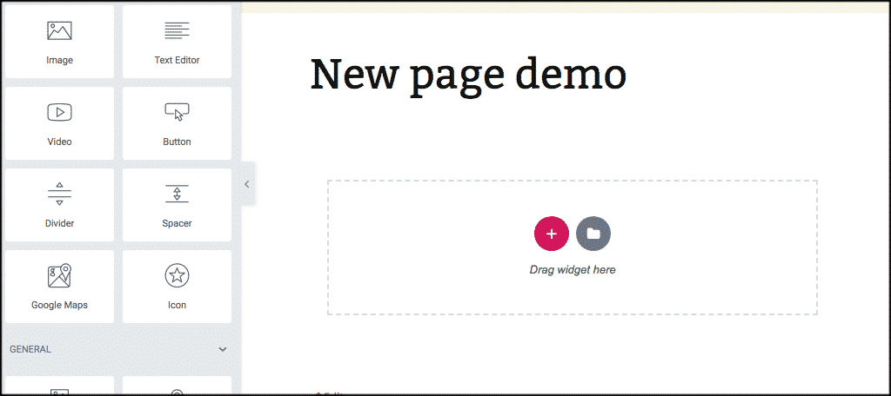
Step 3: Add a New Section
Once the “Edit with Elementor” button has been clicked the Elementor page builder will come up and you will see the complete editing area. This includes the widget panel, editing area, add new section, and add new template area.

Slide 32
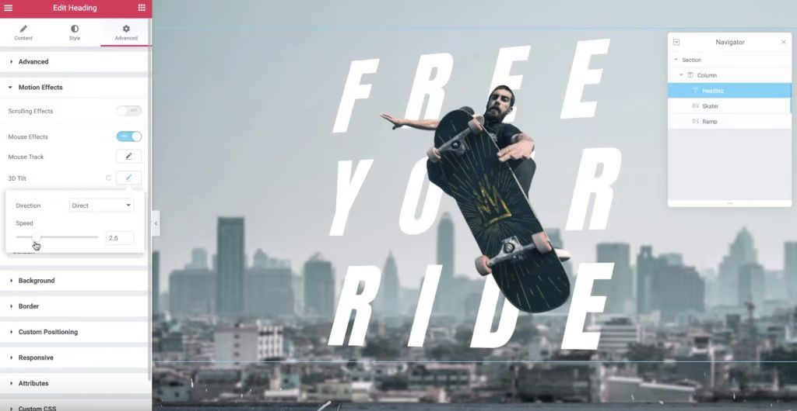
From here you are all set to build so let your creative juices flow. Add as many new sections, columns, and widgets as you want to build out the page. You can complete the above process over and over to build as many pages as you want.
Create Your First Section: Hero

Slide 33
To get started, create a new section and choose a one-column layout. Then:
Set the Content Width to full-width
Set the Columns Gap to no gap
Choose Min Height for the Height and then set it equal to 140 VH
Go to the Style tab and choose the image for the background of your section. Then, you can use the options below to change its position.
Add a Heading widget and click to edit your text. Then, you can use the Style options to change how your Heading looks.
Then, you can add an Image widget below your Heading and set a negative top margin to move it up the page. For our example, that’s the flying skater. You can then add another image for the ramp.
Now, to add motion effects as a visitor scrolls down the page, go to the Motion Effects settings in the Advanced tab and turn on Scrolling Effects. You can then tweak the settings to achieve your desired effect.
Then, you can edit your Heading text and add Mouse Effects in the Motion Effects section. Then, turn on 3D Tilt so that the heading will “tilt” when a user hovers over it.

Slide 34
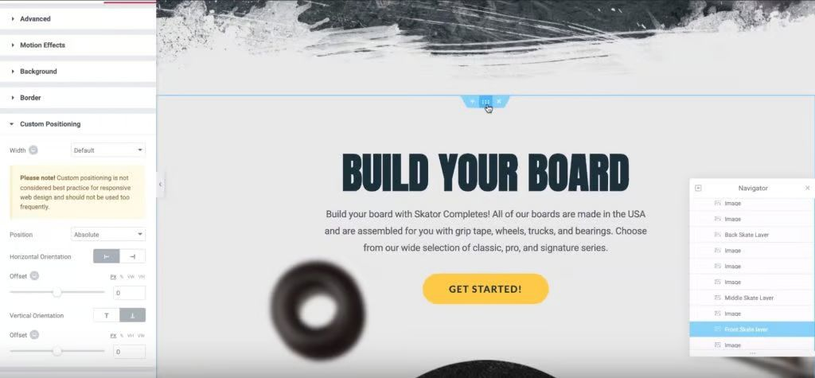
Side note – to keep track of all your page’s elements, you can use Elementor’s Navigator feature. It’s really helpful for staying organized and finding different sections and widgets.
Create Your Second Section: Build Your Board
Next, add another section with a one-column layout and make it full-width.

Slide 35
Then, use the Style tab to add a solid background color and add a Heading widget. Then, you can align your widget in the center and configure its colors and typography
Next, add a Text Editor widget underneath the header and configure its typography and colors.
To create your CTA, add a Button widget below your text widget and configure its style. You can make the button more interesting by adding a Float Hover Animation.
Below that, add three skateboard images and use the Navigator to name them “Front,” “Middle,” and “Back.”
Then, use the Custom Positioning section in the Advanced tab and set all three images to Absolute positioning with a vertical orientation at the bottom. This creates a neat “stacked” effect.
Finally, add images for the wheels and other accessories and use Custom Positioning to position each image. Then, you can use Scrolling Effects in the Motion Effects settings to make the wheels, and other images “move” as users scroll down the page.

Slide 36
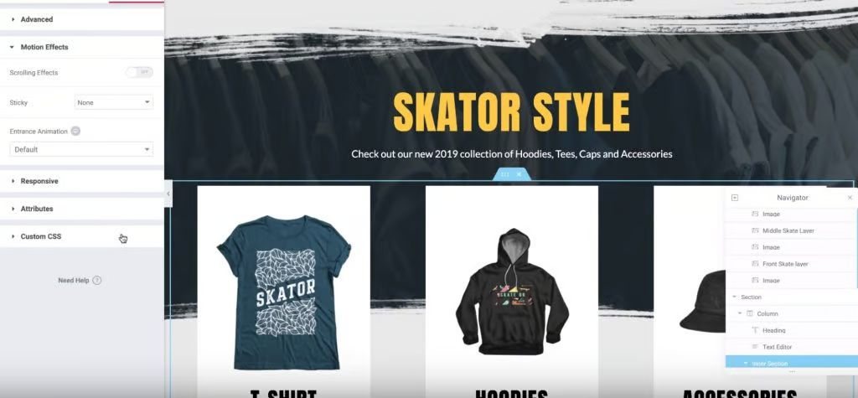
Create Your Third Section: Products
For your third section, create a new section with a one-column layout and set the content width to 1600 and minimum height to 100 VH. Then, add a background image and configure its positioning.

Slide 37
Next, add a Heading widget and configure its typography and colors.
Below that, add a Text Editor widget, insert your text, and align it in the center.
Below the Text Editor widget, add an Inner Section widget and set its width to 1600.
Then, add a Call to Action widget to highlight your products. Make sure to edit the text and image as needed. Then, set the minimum height to 500 px and the vertical position to bottom. You can also play around with the other style options, like changing how the animation works.
Once you’ve finished configuring the widget, duplicate the column twice and delete the empty column on the right so that you have three columns, each with a Call to Action widget.
To add some interest, you can add an Entrance Animation to the Inner Section widget in the Motion Effects settings. Fade in Up is a good option.

Slide 38
Create Your Fourth Section: Meet Our Team
To create your fourth section, once again, create a new section with a one-column layout and make it full-width, with a minimum height of 100 VH. Then, add a solid background color.
Next, add a Heading widget and configure its typography.
Below that, add an Inner Section widget and make it full-width. Then, duplicate the column in the Inner Section widget so you end up with four evenly-spaced columns.

Slide 39

Inside the first column, add a Flipbox widget and edit the text and images to add your first team member. For more interest, you can add the 3D Depth effect. You should also adjust the spacing and alignment as needed.
Once you’ve finished, right-click the column and copy it. You can then right-click and paste the already-configured widget into the other three columns. Then, all you need to do is edit the text and images for each column, which saves you a ton of time.

Slide 40
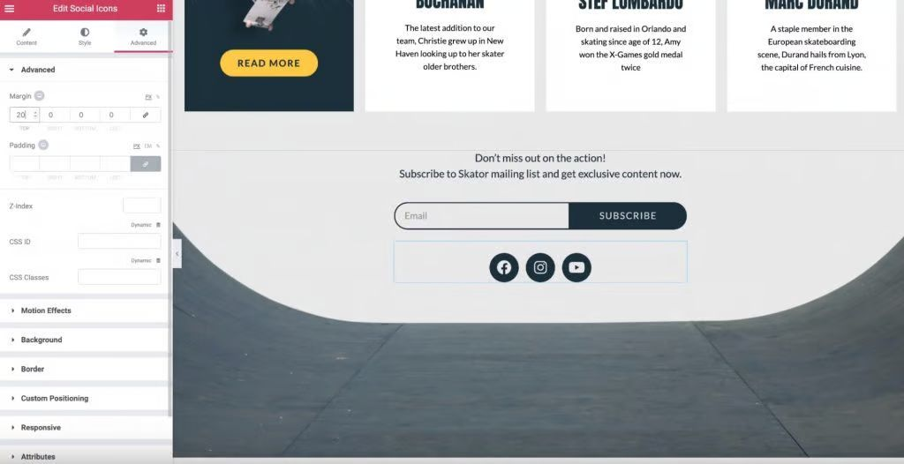
Create Your Final Column: Email Opt-in and Social Follow
To create the fifth and final section, add a new section and use a one-column layout. Then, set the width to 500 px and the minimum height to 60 VH. Then, add a background image and configure the image.

Slide 41
Then, drag in a Text Editor widget, add your text and configure the typography and alignment.
To create an email opt-in form, add the Form widget underneath the Text Editor widget. Then, edit the form fields and delete unnecessary fields. You can also configure the form’s styling to match the rest of your design and connect it with your preferred email marketing service.
Finally, to add your social follow buttons, add a Social Icons widget underneath your opt-in form. Choose which social networks you’d like to use and edit the icons if desired.
And that’s it!
Congratulations, you just created an awesome homepage for your business with Elementor.
After you’ve published your homepage, go to Settings > Reading:

Slide 42
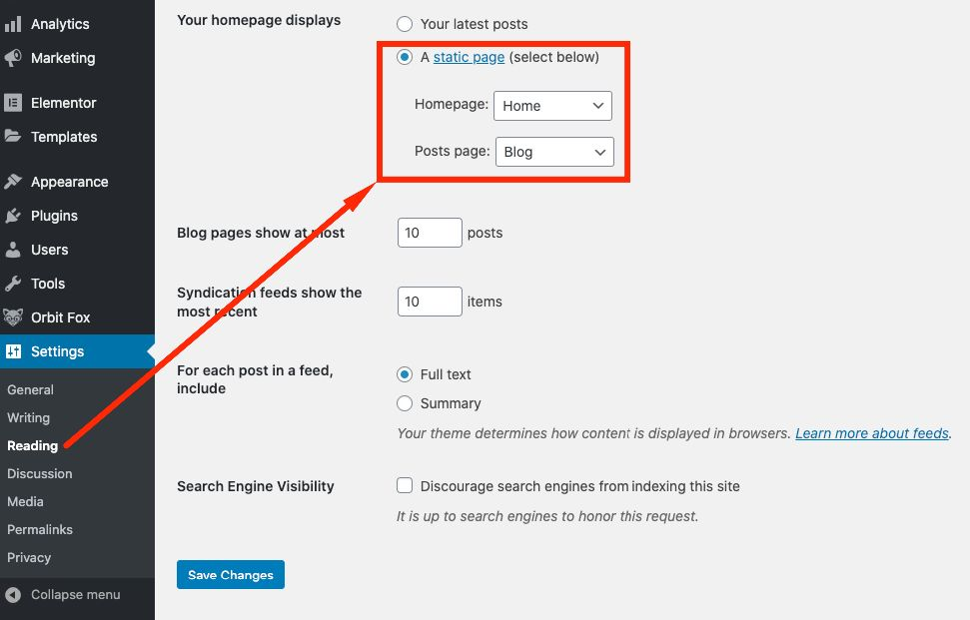
By default, WordPress will set the homepage to Your latest posts. If you use a theme’s demo content or a premade website kit, they almost always take care of switching that setting to A static page as well as the newly created Home page.
If you’re not leveraging premade page designs, you’ll have to configure this by hand from the Settings panel.

Slide 43
Design Other Pages(About us, Contact us, Services)
  1.Create About Us Page
  1. In the left-hand menu, hover over "Pages" and click "Add New".
  2. Enter "About Us" in the title field.
  3. Click "Edit with Elementor".
  2. Design Your Page with Elementor
  Adding a New Section
  Click the "+" button to add a new section.
  Choose the structure (e.g., single column, two columns, etc.).
  Adding Elements (Widgets)
  Drag and drop widgets from the Elementor panel on the left into your section.

Slide 44
  Common widgets for an "About Us" page include:
    Heading: For section titles.
    Text Editor: For paragraphs and descriptions.
    Image: For photos of your team or office.
    Video: To embed a video about your company.
    Icon Box: To highlight your company’s values or services.
    Team Member: To introduce your team members (some themes or add-ons may have specific team member widgets).
Customizing the Content
  Click on any widget to customize it.
  For a Heading, you can change the text, alignment, size, and style.
  For a Text Editor, you can format the text, add links, and use different font styles.
  For an Image, you can upload a new image, add alt text, and adjust the size and alignment.

Slide 45
Adding More Sections
Add additional sections to divide your content into logical parts, such as:
  Company history
  Mission and vision
  Team members
  Achievements and milestones
  Contact information
3. Using Templates (Optional)
Elementor offers pre-designed templates that you can use and customize.
Click on the folder icon to open the Elementor template library.
Browse through the available templates and insert one that suits your needs.
Customize the template to match your brand.

Slide 46

5. Styling Your Page
  Use the Style tab in Elementor to adjust the appearance of each widget and section.
  Change colors, typography, spacing, and more.
  Use the Advanced tab for more detailed adjustments like margins, padding, and responsiveness.
6. Preview and Publish
  Click the eye icon to preview your page.
  Make any necessary adjustments.
  Once you’re satisfied with the design, click the green "Publish" button.
About Us template Design

Slide 47
Create Contact Us Page
1. Create a New Page
In the left-hand menu, hover over "Pages" and click "Add New".
Enter "Contact Us" in the title field.
Click "Edit with Elementor".
2. Design Your Page with Elementor
Adding a New Section
Click the "+" button to add a new section.
Choose the structure (e.g., single column, two columns, etc.).
Adding Elements (Widgets)
Drag and drop widgets from the Elementor panel on the left into your section. Common widgets for a "Contact Us" page include:
  Heading: For the page title or section headings.
  Text Editor: For descriptions or instructions.
  Form: To create a contact form (you might need the Elementor Pro version or an additional form plugin like WPForms).
  Map: To show your location.
  Icon Box: To highlight contact details like phone numbers, email addresses, and physical addresses.
  Social Icons: To add links to your social media profiles.

Slide 48
Customizing the Content
Click on any widget to customize it.
  For a Heading, you can change the text, alignment, size, and style.
  For a Text Editor, you can format the text, add links, and use different font styles.
  For a Form, you can add fields, set up notifications, and customize the form's appearance.
  For a Map, you can enter your address to pinpoint your location.
  For an Icon Box, you can select icons, add text, and link them to relevant contact methods.
3. Using Templates (Optional)
Elementor offers pre-designed templates that you can use and customize.
Click on the folder icon to open the Elementor template library.
Browse through the available templates and insert one that suits your needs.
Customize the template to match your brand.
4. Styling Your Page
Use the Style tab in Elementor to adjust the appearance of each widget and section.
  Change colors, typography, spacing, and more.
Use the Advanced tab for more detailed adjustments like margins, padding, and responsiveness.

Slide 49
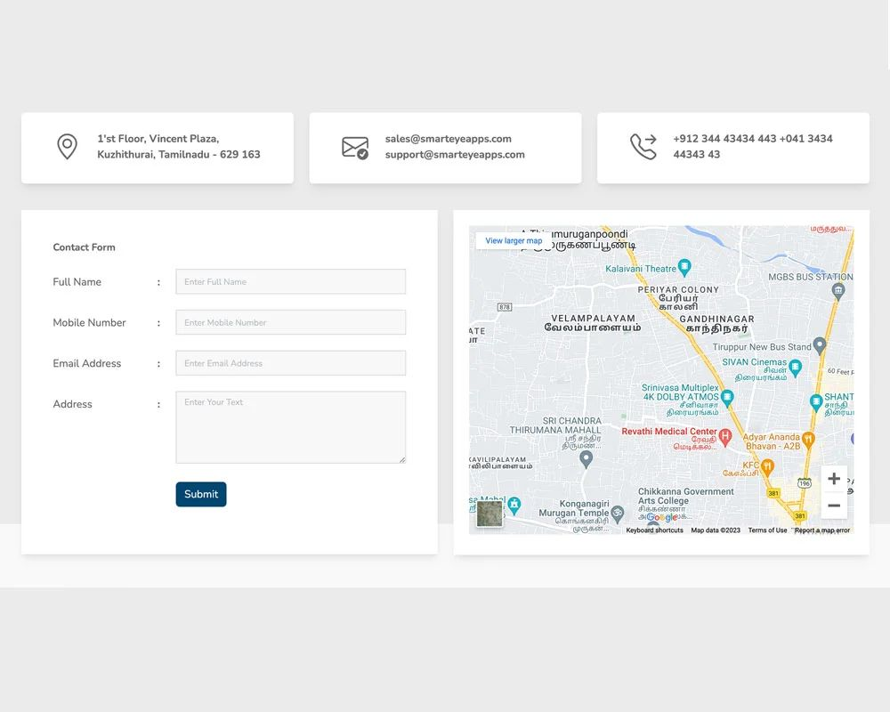
5. Preview and Publish
Click the eye icon to preview your page.
Make any necessary adjustments.
Once you’re satisfied with the design, click the green "Publish" button.
Contact Us template Design

Slide 50
Create Product Page
To Create Product Page , We need WooCommerce Plugin ( Set up E-Commerce) & UPI QR Code Payment Gateway & Razorpay for WooCommerce (For Payment Integration)
From your WordPress dashboard, go to “Plugins”, then “Add New”.
Search for “WooCommerce”. It should pop up as one of the first options. Select “Install”. Once it’s installed, select “Activate”.
You will be asked to fill out some information about your shop and location. This information is vital for making sure you can sell and ship things properly. WooCommerce clearly walks you through all the things you need to include in order to eliminate the guesswork later.

Slide 51
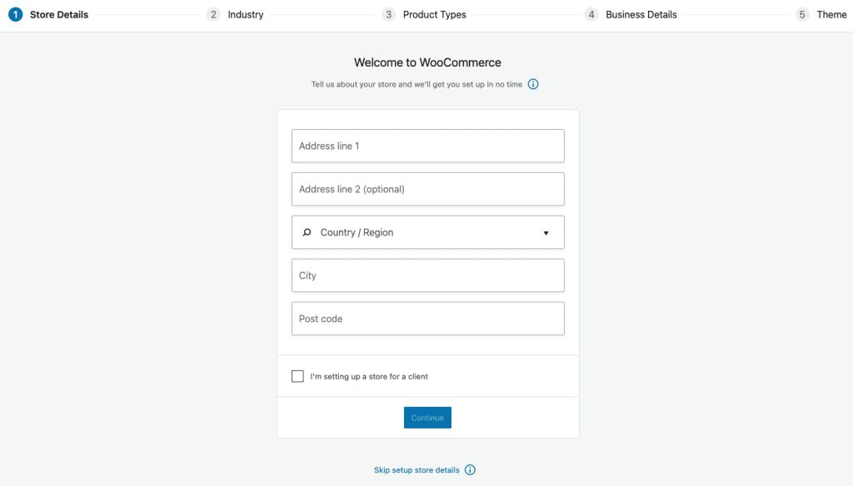

Slide 52
WooCommerce Settings
General Settings
Find and edit the general settings at: WooCommerce > Settings > General
The general settings sections include:
Store Address
General Options
Currency Options
Store Address
Here you define your shop’s address, where you are based as a seller. Many tax and shipping configurations use this address for determining rates.

Slide 53
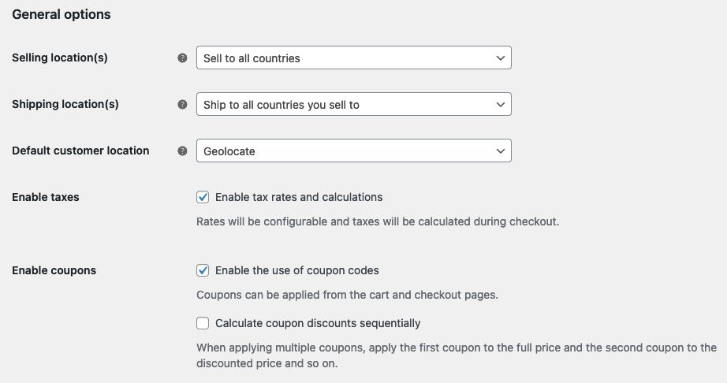
General Options
Selling Location(s) – choose to sell to all countries or to specific countries. You can choose multiple specific countries / regions.
Shipping Location(s) – choose to ship to only those countries you sell to or a subset of countries. You can also disable shipping and all shipping-related functionality.

Slide 54
Default Customer Location – Select the assumed location of site visitors, for use before they input any address information at checkout, in order to calculate default tax and shipping rates. The options for default customer location are:
Shop base address – tells the system to assume customers are in the same location as your shop.
No address – means that taxes and shipping aren’t calculated until a customer enters their address.
Geolocate address – verifies the customer’s current location and calculates taxes and shipping accordingly. Uses the Maxmind Geolocation Integration.
Geolocate with page caching support – is the same as above, but does the geolocation via Ajax. You may notice your website URLs have a ?v=xxxxx appended to them when this option is selected. This is normal to prevent static caching of prices.
Enable Taxes – enable or disable taxes on your store. Disabling taxes hides the tax settings page.

Slide 55
Enable coupons – enable or disable coupons in your store. Coupons are applied from the admin edit order screen (for unpaid orders), cart, and checkout pages.
Enable the use of coupon codes – select to enable the use of coupons in your store. When coupons are enabled you’ll see the below option about how discounts should be calculated.
Calculate coupon discounts sequentially – changes the coupon calculation logic to apply coupons in sequence on top of one another, rather than basing them on the original product prices.

Slide 56
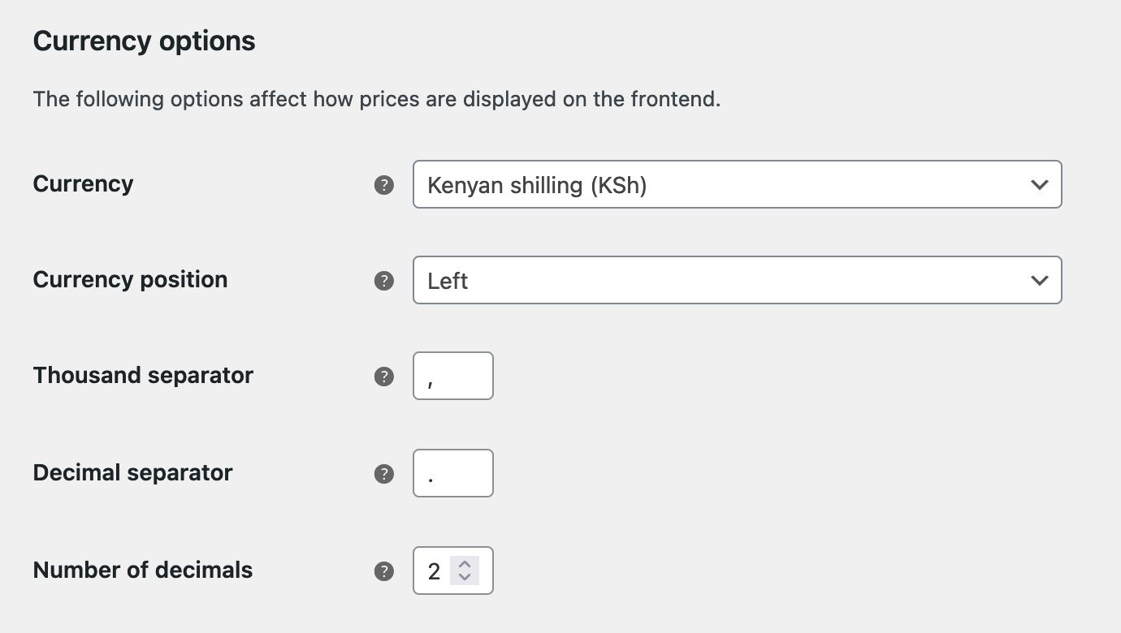
Currency Options
Currency options determine how prices are displayed in your store for customers.
Currency – choose the default currency for the store. Only one may be selected.
Currency Position – choose the default currency position for prices: Left, Right, Left/Right with space

Slide 57
Thousand Separator – choose the symbol to use for the thousand separator: 1,000 or 1.000
Decimal Separator – choose the symbol to use for the decimal separator: 100.00 or 100,00
Number of Decimals – choose how many numbers to display to the right of the decimal when displaying prices: 100.00 or 100
Be sure to save any changes you make before leaving the settings page.
Product Settings
Find and edit the products settings at: WooCommerce > Settings > Products
General
In the General products settings section (WooCommerce > Settings > Products > General) are settings for your Shop Page, Measurements units, and Reviews.

Slide 58
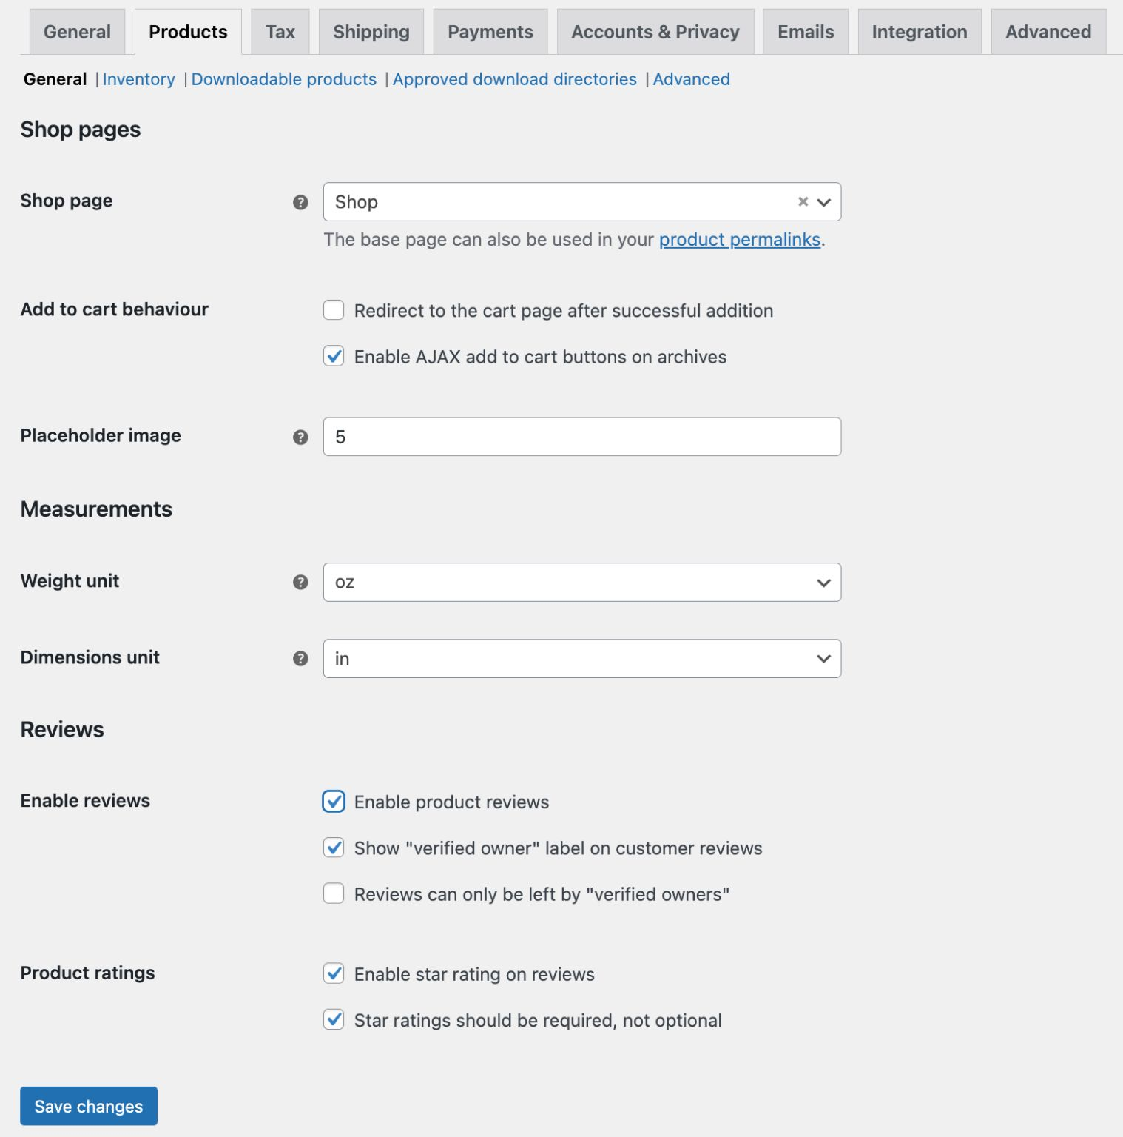

Slide 59
Create Shop Pages/Product Page
Shop Page – select what page you want to be the default shop page. It doesn’t need to be the page named “Shop” that WooCommerce installed, and can be left un-set if you use another method to display products. If no shop page is set, and a page named “Shop” exists, that page will be used as a product archive.
Add to cart behavior – determines what happens after a customer clicks the Add to Cart button.
  Redirect to cart page after successful addition – automatically takes the customer to the cart page upon adding a product.
  Enable Ajax add to cart buttons on archives – using AJAX adds the item to the cart without reloading the page.
Placeholder Image – enter the attachment ID or URL of an image to set as the default placeholder image to appear on the front end when no other image is available. This could be your brand logo or an image of a signature product or service. WooCommerce comes installed with a default placeholder image added to your site’s media library.

Slide 60
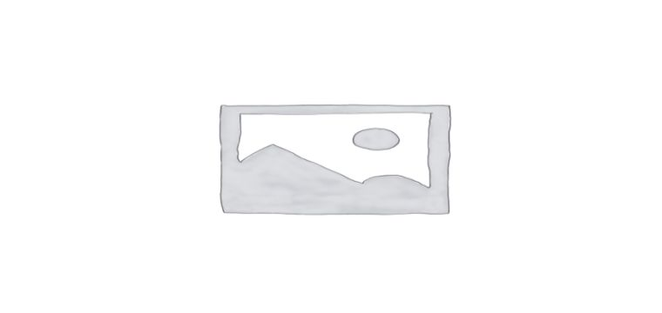
The default WooCommerce placeholder image.
Measurements
Weight unit – Select a unit of measurement for products from the drop-down for weight.
Dimensions unit – Select a unit of measurement for products from the drop-down for dimensions.
Product Ratings (Reviews)
Enable Product Reviews – Tick this box to activate product reviews.
Show “verified owner” label on customer reviews – Tick this box to display when a customer review is from a customer who has purchased the product.
Reviews can only be left by “verified owners” – Tick this box if you want to restrict everyone except for product buyers from leaving reviews.
Enable star rating on reviews: Tick this box to enable star ratings on reviews.
Star ratings should be required, not optional: Tick this box to make star ratings required to leave a review.

Slide 61
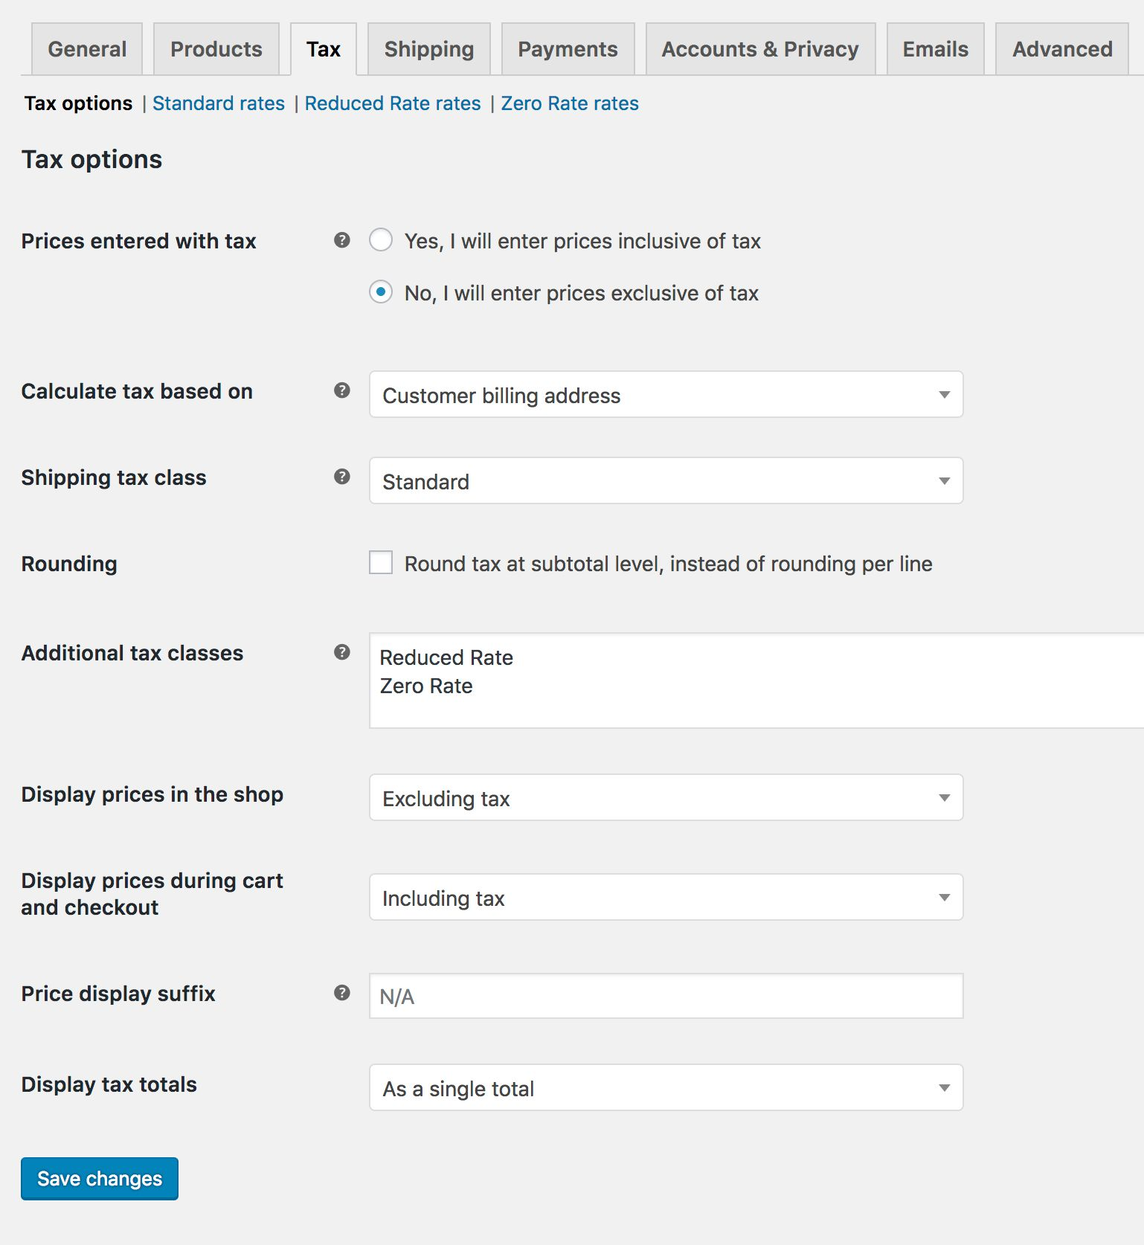
Tax Settings
How to configure tax options in WooCommerce
Once enabled, access the WooCommerce tax settings in the Tax tab by going to WooCommerce > Settings > Tax.

Slide 62
Prices entered with tax
The Prices entered with tax option is perhaps the most important setting when you manage taxes in your store. It determines how you enter your product prices. There are 2 options to select from:
Yes, I will enter prices inclusive of tax – enter all product prices including your store’s base tax rate. [(i.e. Product Price(display 1000rs) + Tax(10% gst) = Total Price(1100rs))] – Total Price Shown on the Cart
No, I will enter prices exclusive of tax – you should then enter product prices without tax. [(i.e. Product Price(display 1000rs) = Total Price(1000rs))] – Total Price Shown on the Cart is 1000rs + Tax(10% GST) but have to pay Total Price Rs1100

Slide 63
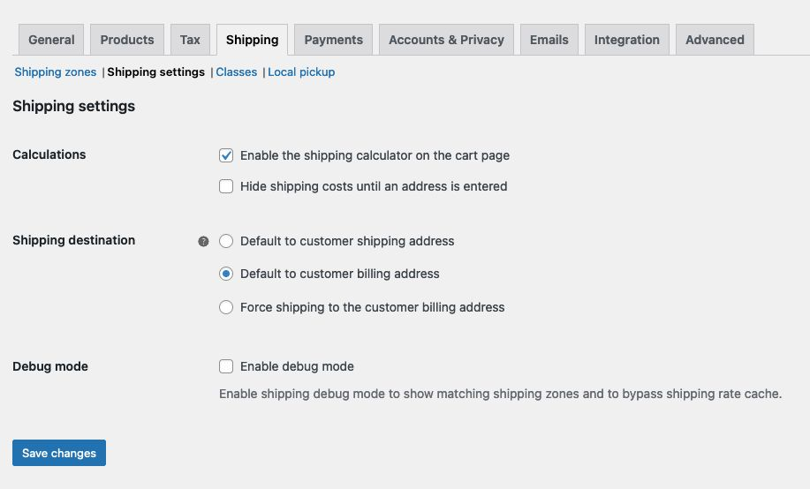
Shipping Settings
Find and edit the shipping settings at: WooCommerce > Settings > Shipping.

Slide 64
The “Shipping settings” page has the following settings:
Calculations
  Enable the shipping calculator on the cart page
  Hide shipping costs until an address is entered
Shipping Destination
  Ship to billing address or customer shipping address by default or only ship to the user’s billing address.
Debug Mode
  Enabling debug mode will display the customer’s matched shipping zone in a notice on the site’s front-end, and bypass the shipping rate cache. Enable for troubleshooting purposes.
Shipping Classes
Shipping classes can be used to enable shipping methods to provide different rates to different classes or types of products.
Local Pickup
Local Pickup is an option that allows the customer to pick up an order themselves.

Slide 65
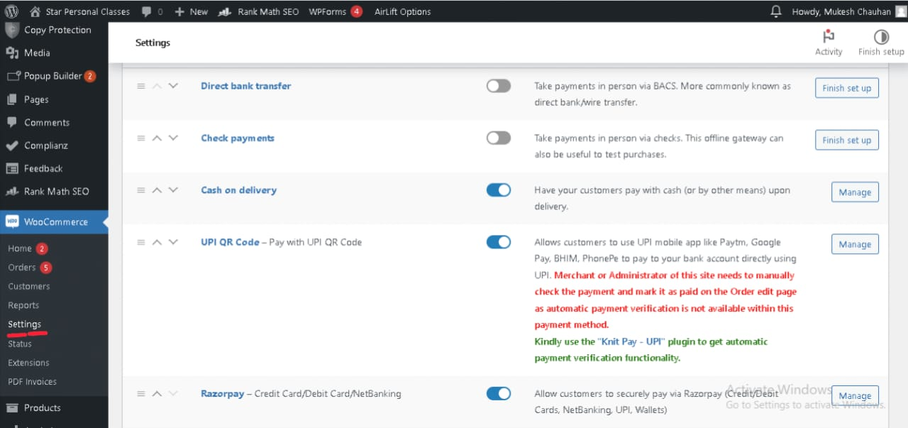
Payments Settings
Go to: WooCommerce > Settings > Payments to control which payment gateways are enabled, and to configure each gateway’s settings.

Slide 66
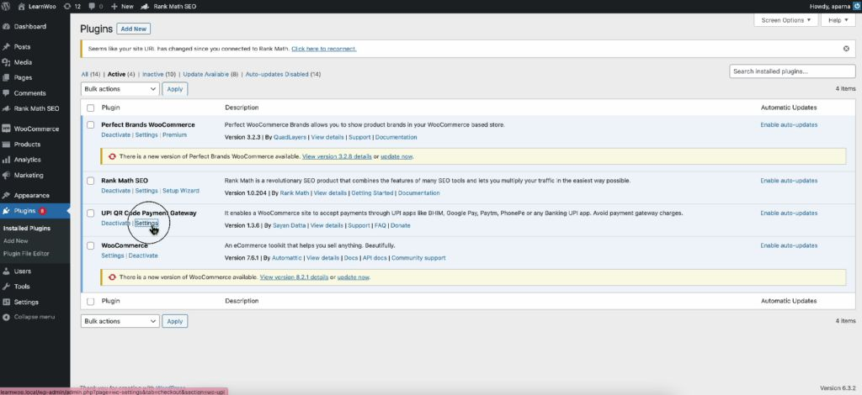
UPI QR Payment setting
Configuring the Plugin Settings
Now that the plugin is installed, let’s configure the settings.
In the WordPress Dashboard, go to Plugins → Installed Plugins.
Find the newly installed UPI Payment Gateway plugin and click on ‘Settings.’

Slide 67
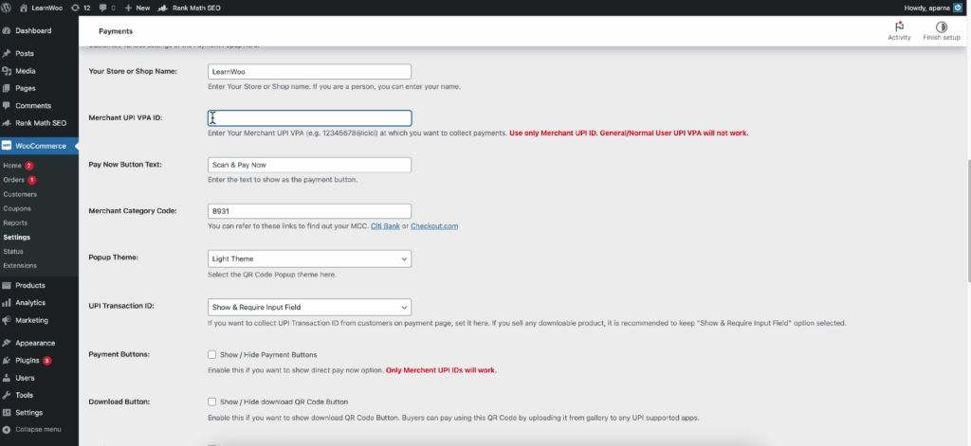
Scroll down to the ‘UPI VPA ID’ option and enter your UPI ID (PhonePe, Google Pay, etc.).

Slide 68
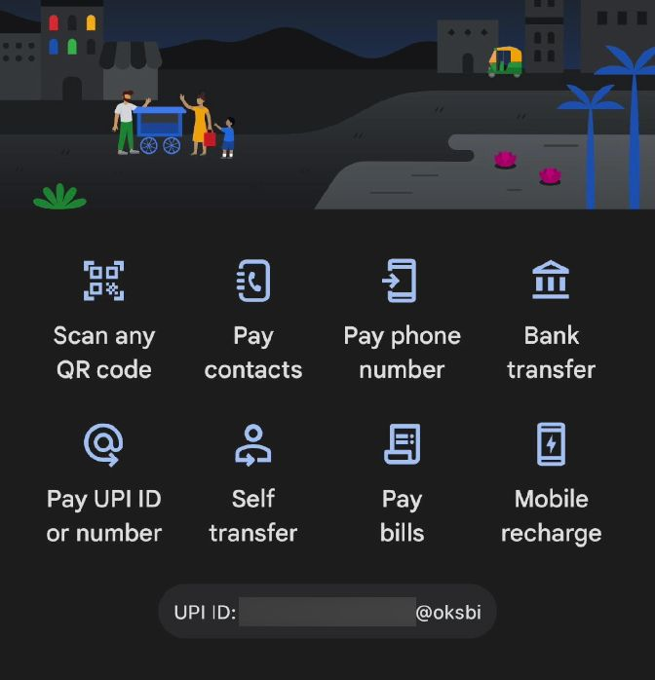
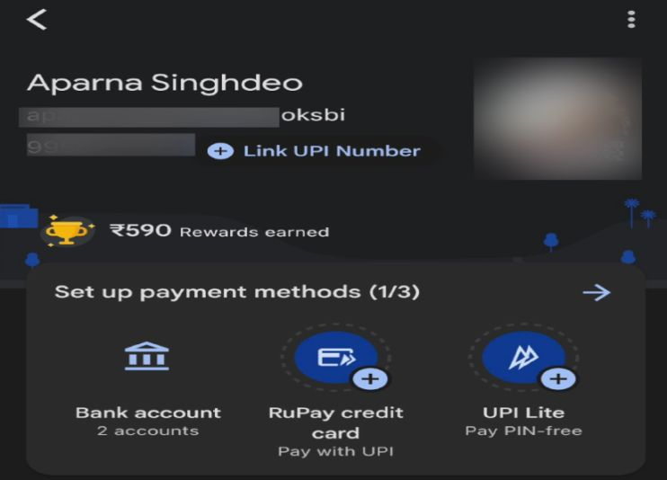
Getting Your UPI IDs
For the convenience of your customers, let’s explore how to obtain UPI IDs from popular payment gateways
For Google Pay
Open your Google Pay account.
Find your UPI ID either on the main page or in your profile settings.
Copy the UPI ID and paste it in the respective field on the plugin’s settings page.

Slide 69
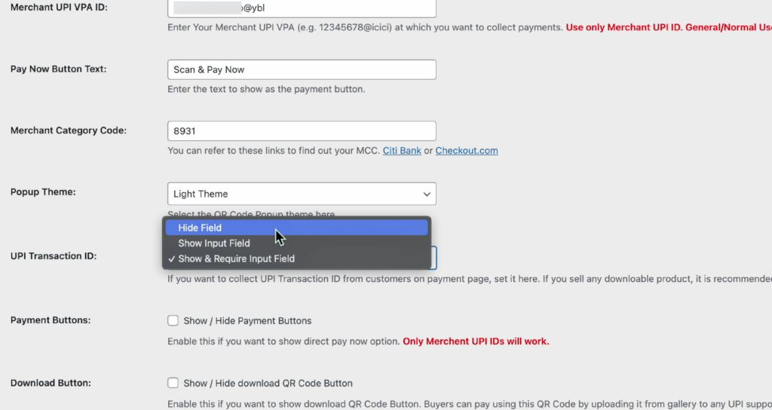
Additionally, choose ‘Hide it’ from the dropdown menu for the UPI Address option.
Once done, click ‘Save Changes.’

Slide 70

Testing UPI Payments on Your WooCommerce Site
Now that your plugin is configured, let’s ensure that the UPI payment option is successfully added to your WooCommerce site.
To check that, visit your shop page, now add products to the cart, and proceed to the checkout page.
On the checkout page, you’ll see the newly added UPI Payments option.
To complete the process, simply click on ‘UPI’ and proceed with the payment.

Slide 71

Razorpay Integration with Woo commerce
Steps to integrate your WooCommerce website with Razorpay Payment Gateway.
Step 1: Install Plugin and Activate
Step 2: Configure WooCommerce
Log in to your WordPress account and activate the Razorpay plugin in the WordPress Plugin Manager.
Log in to your WooCommerce account, navigate to Settings and click the Checkout/Payment Gateways tab.
Click Razorpay to edit the settings.
Enable the Payment Method, name it Credit Card/Debit Card/Internet Banking. This is shown on the Payment page your customer sees.

Slide 72
Add in your [KEY_ID] and [KEY_SECRET] generated from the Razorpay Dashboard.
Set the Payment Action to Authorize and Capture to auto-capture payments. If you want to capture payments manually from the Dashboard after manual verification, set the Payment Method to Authorize.
Handy Tips
Webhook is auto-configured when you enter and save the API key ID and secret on the plugin settings page. You need to verify if webhooks are enabled on your Razorpay Dashboard. However, for versions lower than 3.5.0, you need to configure webhooks manually.
Verify Payment Status
You can track the payment status from the Razorpay Dashboard or poll our APIs.

Slide 73

Verify Payment Status From Dashboard
Log in to the Dashboard and navigate to Transactions → Payments.
Check if a payment ID has been generated and note the status. In case of a successful payment, the status is marked as captured.

Slide 74
Poll APIs
Poll Payment APIs to check the payment status.
Test Integration
Steps to test if the WooCommerce integration was successful.
After the integration is complete, a Pay button will appear on your web page/app. You need to click the button and make a test transaction to ensure that the integration is working as expected. You can start accepting actual payments from your customers once the test is successful.
You can make test payments using one of the payment methods configured at the Checkout.
No money is deducted from the customer's account as this is a simulated transaction.
Ensure you have entered the API keys generated in the test mode in the Checkout code.

Slide 75
Add New Product
Each product you sell on your WordPress site should get its own product page. Once a product has a product page, it can be added to your store.
Remember that you don’t need a page for each individual product variation that you have offer. For example, maybe you sell 3 different t-shirt designs and each comes in 3 colors and 4 sizes. That comes out to 36 possible combinations. But you don’t need to build 36 pages. Instead, consider building 3 different product pages (one for each design) and each one can have attributes so that buyers can choose the color and size they want.
It’s a good idea to have a spreadsheet or list handy of all the products (and their variations) for which you need to build pages.
To build your first product, go to your Dashboard, then go to “Products”, and “Add New”.

Slide 76

There are a few sections you will need to fill out before publishing your first product:

Slide 77
Product Name – This should be fairly short, but descriptive. Avoid keyword stuffing!
Product Description – This is where you can go into depth about what makes this product amazing. Think about describing what it’s made of, what it could be used for, etc.
Category – It’s a good idea to sort products into basic categories. If you need inspiration, check out a competitor’s website to see how they sort their products.
Tag – Tags are optional, but very handy for sorting. Tags could describe things like color, size, style, flavor, etc.
Image – Upload at least one high quality image showing off the product. Showing images being used or worn is often preferable to showing them on a plain background.
Price – This part is self-explanatory!
Stock (optional) – Do you only have a limited number available? Add a stock number so that you don’t oversell.
Shipping – Add your shipping details if you are mailing products to buyers directly.

Slide 78

Attributes (optional) – If you have variations of your product, add them here. For example, we talked about t-shirts before. This is where you would add details like styles, sizes, colors, etc. so that the buyer can select the exact kind of t-shirt they want.
Once all of these options have been set, your product is ready to publish! Click the “Publish” button to publish this product.
Congratulations! You can view your product now using the “Preview” button.

Slide 79

In order to populate your shop, you will need more than one product. Repeat these steps for all the products that you would like to sell. Remember to keep categories and tags in mind; these will help your customers find the right products through your shop page.

Slide 80

Anatomy of a Great Shop Page
The WooCommerce Shop page provides you with a grand list of all your products.
Users can view the product title, image, price, and a bit of extra information. Clicking on a product takes the visitor to the individual product pages we just built.

Slide 81
Your Shop page must at least include this product list with options to search or filter those products. Customization for those filtering tools is up to you!
This default shop layout will function perfectly well.
Note : Shop Page by default created by WooCommerce, you just need to Add your Products

Slide 82

Set Up Menus

Slide 83

Steps to Create New Menu:
From the 'Appearance' menu on the left-hand side of the Dashboard, select the 'Menus' option to bring up the Menu Editor.
Select Create a new menu at the top of the page
Enter a name for your new menu in the Menu Name box
Click the Create Menu button.
After that, Click on View All Left hand Side, Select Pages which you wants to display , Click Add to Menu then click on Save
Note: You can Drag and Drop Pages Option according to your preference

Slide 84

Create Post
To Create, blog post you have to go the Posts> Add New

Slide 85
Create your first Blog Post
Write Title on the above, make ensure that your permalink should match with your title of blog post
permalinks provide the full URL address of a post or page on your website
Below in Content area, Add your content here
  1. Click on + icon here options available select Heading for Writing heading
  2. For Writing Content, Click on + icon>Paragraph
  3. For Adding images Click on + icon search image click on that choose Upload image> Select from your Computer> Pick image
  4. Add many more options available. You just need to check it out
On the Right side Add Feature image> Add Categories> Add tags> click on Publish
Now your blog Post is ready.

Slide 86

Blog Post Writing Image

Slide 87
SEO and Analytics
Optimize your site for search engines using an SEO plugin (e.g., Yoast SEO, RankMath).
Use keywords, meta descriptions, and alt text for images.
Set up Google Analytics to track visitor behavior and site performance.
How to Optimize Your WordPress Site with Rank Math SEO
Installing the Rank Math Plugin
Log in to your WordPress admin panel.
In the left column navigation, mouse over the “Plugins” link and click the “Add New” link.

Slide 88

In the “Search plugins…” box, enter, “Rank Math.”

Slide 89

When you find the plugin, click the “Install Now” button.

Slide 90


Now the plugin is installed, but it has to be activated before you can use it.
Click the “Activate” button.

Slide 91

2. Connecting and Configuring Rank Math
When you activate the plugin, you’ll be taken to a page asking you to connect your site to Rank Math.
click the “Connect Your Account” button.

Slide 92

If you’re currently using another WordPress SEO plugin, Rank Math will ask if you want to import your existing settings. Do it! It will save time, and you won’t have to go back and apply settings to old posts. Rank Math will automatically fix a lot of problems that could be caused by your current SEO plugin. Even if you weren’t aware of any problems.
Next, you’ll be asked to choose a setup path. The current options are “Easy” and “Advanced.”
If you choose the Easy setup, the advanced options will still be available later in the plugin configuration.
So, I’ll check “Advanced” and click the “Start Wizard” button.

Slide 93
Configuring Your Website Information
Here’s where you tell Rank Math what your site is about and upload images for Google and social sharing.
My Blog is a… – Choose the description that most closely matches what your website is about. This is important in SEO because different schema types are used for different subjects. I’ll leave this set to “Personal Blog.”
Logo for Google – If you have a site logo, upload it here. If it’s a personal website, a picture of you is also appropriate. A square image is preferred, but it isn’t mandatory. However, search engines that display squares may crop your image if it isn’t.
Default Social Share Image – This is the image that Facebook shares will use by default. (Other social sites that use Open Graph metadata will use it also.) Their suggested dimensions are for a rectangle, so that’s what I’ll upload. Though more typically, you’ll see share images on Facebook as squares. Again, for a business site, you’ll want something that includes your logo.

Slide 94


When you’re finished, click the “Save and Continue” button.

Slide 95

Connecting Rank Math to Google Search Console
Rank Math recommends connecting to Google Search console. It’s not a requirement, but it will greatly enhance what the plugin can do. So let’s set it up.
Click the “Get Authorization Code” button.

Slide 96

A popup window will open, prompting you to log into your Google account.
Once you’ve connected, a code will be displayed in the popup window. Copy it and paste it into the “Search Console” field in Rank Math.

Slide 97

If you have more than one website connected to Search Console, select the site you’re setting up from the drop-down.
Click the “Save and Continue” button.

Slide 98
Sitemap Settings
Sitemaps help search engines discover and understand the contents of your site. They’re an essential ingredient in your SEO efforts.
Sitemaps – This control toggles sitemaps on or off. The option should be on by default. If the toggle switch is blue, you’re good to go.
Include Images – This controls whether the images in your posts and pages are included in the sitemap. For most of us, we’ll want to include images. It increases the number of ways the site can be found. It isn’t absolutely necessary to include images, though. If you’d rather not have the images on your site included, turn this option off.
Public Post Types – This lets you control which post types and pages are included in your sitemap. If you have custom post types, they’ll show up here. If you use a post type for content that is not public (paywall or password protected), deselect it here.
Public Taxonomies – Taxonomies are categories and tags. Just like the Post Types option, you’ll want to deselect any non-public taxonomies.

Slide 99

When you’re finished, click the “Save and Continue” button.

Slide 100
SEO Tweaks Settings
These are settings that will be applied to the contents of your articles and pages.
Noindex Empty Category and Tag Archives – This prevents empty categories and taxonomies from being added to your sitemap. Leave it on, as empty sitemap categories can be seen by search engines as a negative factor.
Nofollow External Links – This is off by default, probably because WordPress automatically nofollows links in comments. For most websites, I wouldn’t recommend adding nofollow to all of your outgoing links. So leave this option off unless you have a strong reason for (or opinion about) using it.
Open External Links in New Tab/Window – Whether clicking your links spans a new browser tab or window is a personal preference. Many eons ago, it was considered rude to force anything to happen on a visitor’s computer or device. But now it’s much more accepted. And opening external links in a new tab keeps the visitor on your site in the original tab. Making it more likely that they’ll continue on your site after visiting the external link.

Slide 101

It’s worth noting that the link options don’t change your existing content. They’re inserted “on the fly” when the page renders. So the decisions you make here are easily changed.
Click the “Save and Continue” button.
That’s the end of the setup wizard. You can return to the settings you’ve made in it at any time. Just go to Rank Math > Setup Wizard in your WordPress admin dashboard.

Slide 102

3. SEO Analysis Should Be Your First Stop After Setup
There are many other configuration options and tweaks that this tutorial can’t adequately cover. Take some time to investigate all of the Rank Math options and settings.
In the left column navigation, mouse over the “Rank Math” link and click the “SEO Analysis” link.

Slide 103

Click the “Start Site-Wide Analysis” button.
The analysis results are displayed in graphs with the details below.

Slide 104


You want to do all you can to address any items that failed tests or generated warnings.

Slide 105

For many failures and warnings, Rank Math has provided tips on fixing the problem. Take a look a those. They’re full of helpful information and SEO knowledge.

Slide 106

4. A Quick Look at Rank Math in Action
In addition to analyzing your site and helping you improve it, you can find all of the new SEO settings under a new tab labeled SEO within the Elementor editor.
SEO for the Page or the Post in the Elementor

Slide 107

Below the focus keyword box on the General tab, you’ll find one of the most important features in this integration: the smart suggestions. These are what make working with SEO within Elementor a smooth, painless process.

Slide 108
Maintenance
Perform regular backups
Update WordPress core, themes, and plugins
Delete unused themes and plugins
Regularly check and optimize your website for speed
Harden your site’s security
Optimize the database
Delete unreferenced and unused files
Check and fix broken links
Test your forms from time to time
Regularly check and optimize your site for mobile
Backup your website to prevent data loss (use plugins like UpdraftPlus).
Monitor site performance and make improvements as needed.

Slide 109
It opens up a single-post analysis similar to what we saw in the site-wide analysis. And like the site-wide analysis, there are numerous tips on improving SEO for your article or page.

Slide 110
Thank You

